Slide 1
Official name of the centre
Name of parent organization
Country / Location / Address with zip code
Copenhagen Academy for Medical Education and Simulation (CAMES)
Website link (functional)
Centre for Human Resources and Education, The Capital Region of Denmark
CAMES Rigshospitalet: Ryesgade 53B, opg. 98A, 2100 Copenhagen, Denmark
Learning Technology: Ryesgade 53B, opg. 98A, 2100 Copenhagen, Denmark (from 1st of Feb. 2022)
CAMES Herlev: Herlev Ringvej 75, 2730 Herlev, Denmark
CAMES Rigshospitalet: https://www.regionh.dk/CAMES-english/Pages/default.aspx
CAMES Herlev: https://www.regionh.dk/CAMES-english/Pages/default.aspx
Learning Technology: https://www.regionh.dk/e-learning/Sider/default.aspx

Slide 2
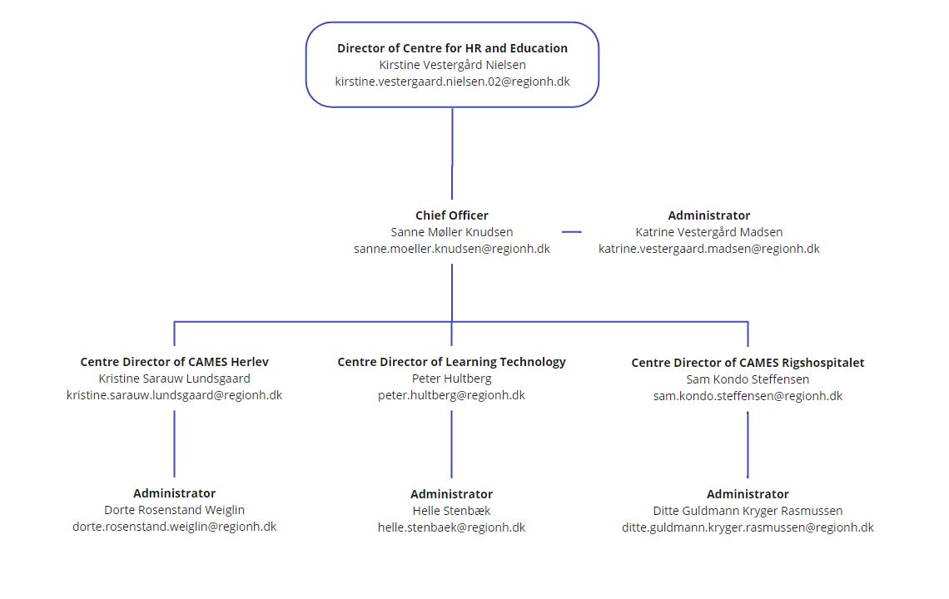
Governance & Administration

